Slide 1



Chapter Two:
Sensation and Perception

Slide 2
Brainstorming
Have you heard of sayings like „you watch but you don't see‟; „you hear but you don't listen‟, „you touch but you don't grasp…‟ What do these statements suggest to you? Which one do you think refers to sensation and which one refers to perception?

Slide 3
2.1. Definition and concepts of sensation and perception
Sensation- the passive process of bringing information from the outside world into the body and to the brain
process by which an organism responds to the stimulus/information.

Slide 4
2.2. The sensory laws
Sensory thresholds and sensory adaption.
There are certain sensory laws that explain how sensation works.
Sensory threshold and sensory adaptation are the two general laws of sensation.
Threshold is the line between not perceiving and perceiving in a given physical energy (stimulus)

Slide 5
1. Sensory threshold
Sensory threshold is the minimum point of intensity a stimulation can be detected
1)Absolute threshold-the minimum value of a stimulus that must be present to be detected.
E.g., a 1 spoon of sugar may be detected in a cup of tea.
2) Difference threshold –
In addition to detecting the presence of a stimulus, you also detect changes in the intensity of a stimulus.
the smallest level of added or reduced stimulation required to sense that a change in stimulation has occurred.
-Or it is the minimum detectable difference between two stimuli.

Slide 6

E. W/G
September, 2008
Absolute threshold - the smallest intensity of a stimulus that must be present for it to be detected for e.g.,
Sight- a candle flame can be seen 30 miles away on a dark, clear night
Taste – a teaspoon of sugar can be detected in 9 liters of water
Smell – 1 drop of perfume can be detected in a 3 room apartment
Hearing – the ticking of a watch can be heard 20 feet away under quiet
Touch – the falling of a bee’s wing from 1 cm height can be felt on a cheek
Transduction
Difference threshold (Just Noticeable difference) - the smallest detectable difference between two stimuli
Sensory adaptation - an adjustment in sensory capacity following long period of exposure to stimuli

Slide 7
Cont……
Weber’s law: physical intensity vs perceptual (psychological) experience; the idea that the JND of a stimulus is a constant proportion despite variations in intensity. (2% change for weight; 10% change for loudness; 20% for taste of salt)
Sensory adaption- when stimulus is un changing, receptors stop responding, this is known as sensory adaptation.
Sensory overload- it refers to excessive stimulation that can lead to fatigue and mental confusion.
E.g., you may go to super market to buy a phone, if d/t style of phones are there, then you may be confused to select & buy the best one among the d/t phones.

Slide 8

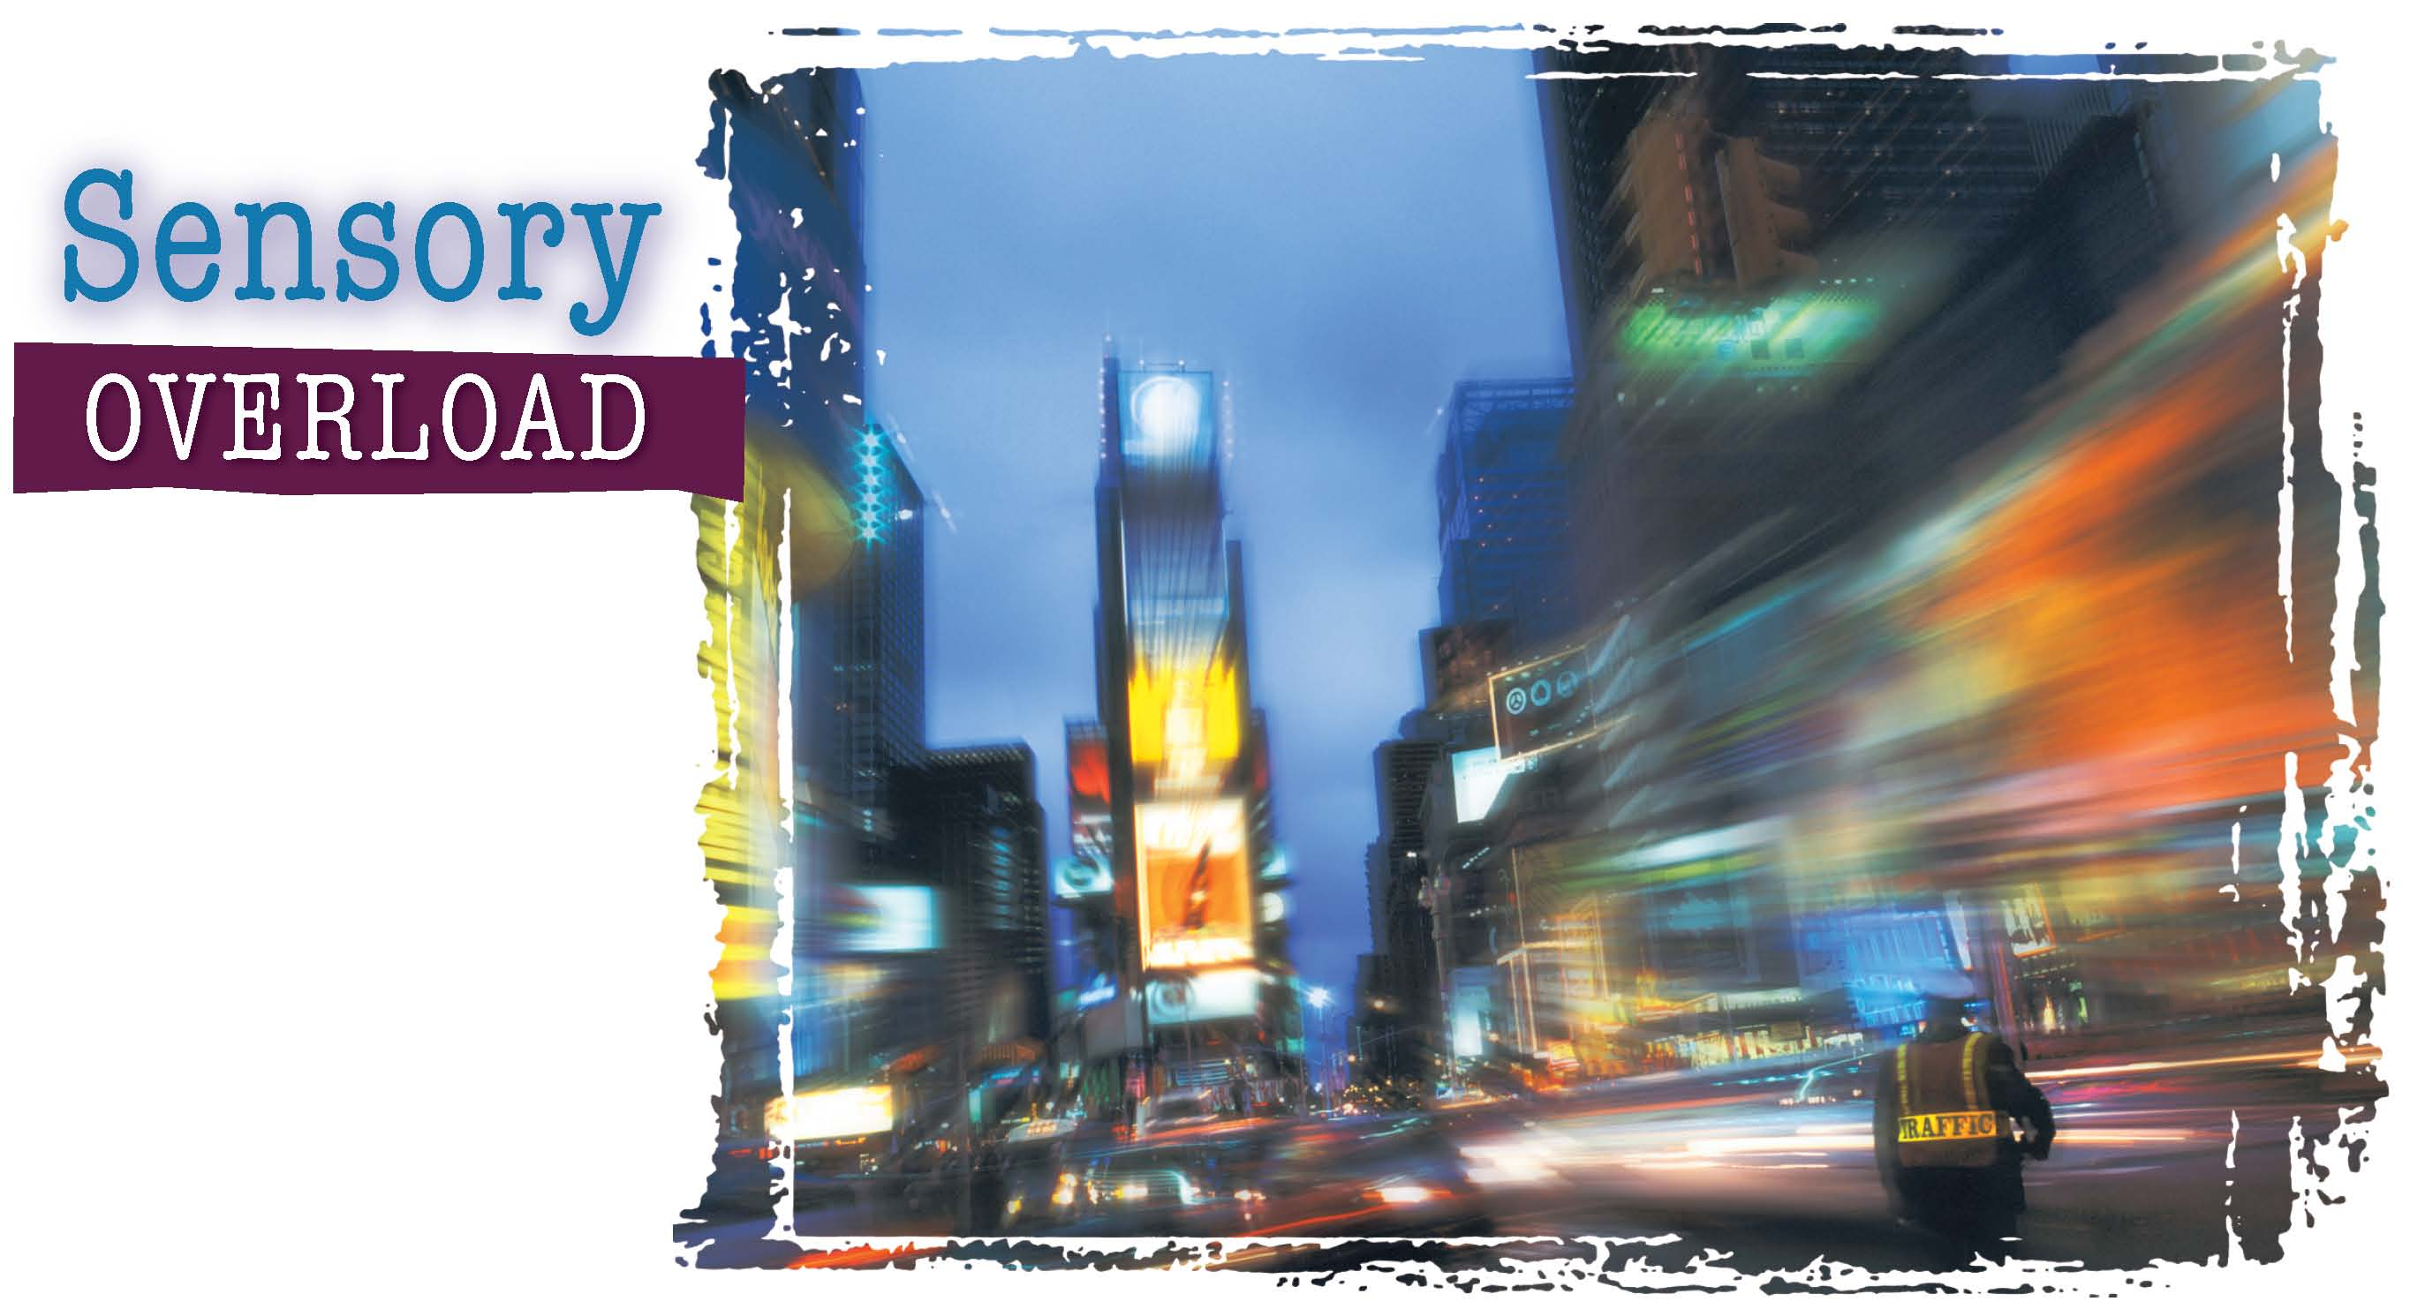
Can you ever see, hear, and feel too much?

Slide 9
Stimulation of the Senses
Sensation is the stimulation of sensory receptors and the transmission of sensory information to the central nervous system. Stimulation of the senses is automatic. Perception is the psychological process through which we interpret sensory stimulation.
Absolute Threshold
Difference Threshold
Absolute threshold is the weakest amount of a stimulus that can be sensed.
Absolute thresholds differ from humans to animals and also from person to person.
The minimum amount of difference that can be detected between two stimuli is knows as the difference threshold.
People’s individual difference thresholds vary slightly.
Notes:
–

Slide 10
2.3. Perception
Perception–cognitive process of selecting, organizing, and interpreting the information brought to the brain by the senses.
In the other ways, it is the acquisition, selection, organization and interpretation of sensory information

Slide 11
2.3.1. Selectivity of Perception
Perception, in general, consists of three basic processes:
These are: Selection, organization, interpretation
1 Selection/attention
Select the stimuli to which we will attend
We perceive only a few of them clearly from a given moment.

Slide 12
Selectivity (Contd)
The selectivity of perception implies, among other things, that our field of experience is divided into what is known as Focus and Margin.
Events or stimuli that you perceive clearly are the focus of your experience and other items or stimuli that you perceive dimly or vaguely are in the margin of your attention. You may be aware of items in the marginal field but only vaguely or partially.
Factors affecting selectivity of perception
Stimulus conditions: bigger and brighter, moving
Psychological conditions: Set or expectancy and motives or needs

Slide 13
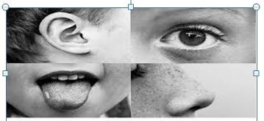
Selectivity (Contd)
2-Organization-the process by which we structure the input from our sensory receptors. (i.e., we mentally arrange the information).

Slide 14
Selectivity (Contd)
3- Interpretation- explain and make judgments about the external world for our life.
To measure our senses (i.e., how much stimulus is enough to detect?) psychologists relay on threshold (the line between not perceiving and perceiving).

Slide 15

Selectivity (Contd)

Slide 16
2.3.2. Form perception
Refers to the way sensations are organized into meaningful shapes and patterns.
Gestalt Psychologists were concerned with meaningful patterns or wholes.
Figure–ground - the tendency to perceive objects, or figures, as existing on a background.
2. Reversible figures - visual illusions in which the figure and ground can be reversed

Slide 17

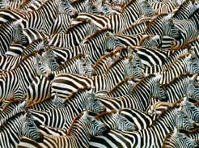
The white and black stripes on these zebras can be reversed – both can serve as either figure or ground
Wine goblet or two faces looking each other?

Slide 18

Figure 4.29
FIGURE 4.29 A reversible figure-ground design. Do you see two faces in profile or a wineglass?

Slide 19
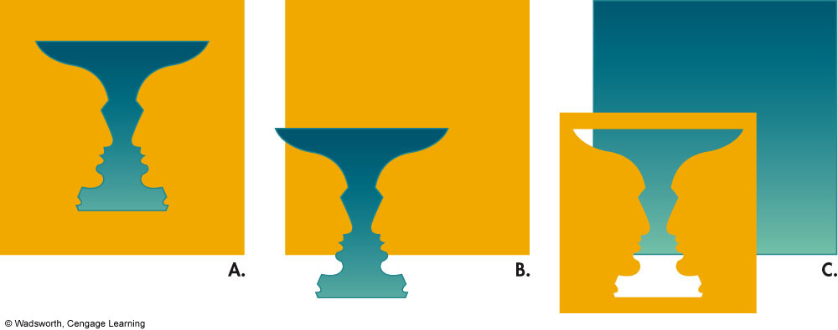
2. Perceptual Organization
Figure – Ground Perception
  Ambiguous, unstable figures, we shift back & forth
Notes:
Example of Figure and Ground are available in the textbook, Figure 4.9.

Slide 20
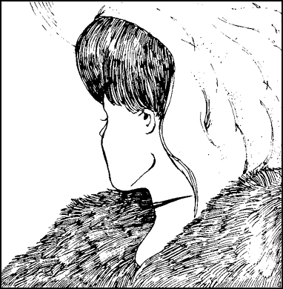
Notes:
Principles of Gestalt Psychology
When looking at an image, we make a distinction between figure and ground.
This is a picture of a reversible figure – a stimulus that can be perceived in more than one way. When we decide which side is the front of the object, then we will see it as a stable image. We are imposing order on an array, not just adding up small features.

Slide 21
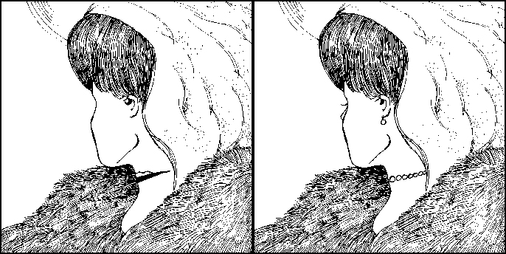
Notes:
Figure 4.22
Unambiguous drawings of the young and old woman. These versions of the reversible figure in Figure 4.21 have been redrawn slightly to make the young woman more apparent on the right and the old woman more apparent on the left.

Slide 22
Contours in Form Perception

Slide 23
Organization in Form Perception
Organization in perception partially explains our perception of complex patterns as unitary forms, or objects
Gestalt psychologist said ―the whole is more than the sum of its parts
When several objects are present in the visual field, we tend to perceive them as organized into patterns or groupings

Slide 24
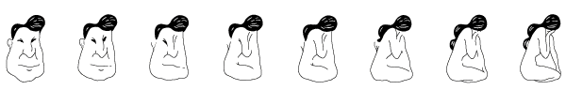
Perceptual Set
What you see in the centre figures depends on the order in which you look at the figures:
  If you scan from the left, see an old man
  If you scan from the right, see a woman’s figure
Notes:
Sensation & Perception
©1999 Prentice Hall
Figure 3.28 from:
Kassin, S. (1998). Psychology, second edition. Upper Saddle River, NJ: Prentice Hall.

Slide 25
Laws of Perceptual Organization
Some of the laws of perceptual organization include: Proximity, similarity, continuation. closure

Slide 26
Laws of perception (Contd)
Similarity - the tendency to perceive things that look similar to each other as being part of the same group.
Proximity - the tendency to perceive objects that are close to each other as part of the same grouping.
Closure - the tendency to complete figures that are incomplete.
Continuity - the tendency to perceive things as simply as possible with a continuous pattern rather than with a complex, broken-up pattern.
Contiguity- the tendency to perceive two things that happen close together in time as being related.
Common fate says that people assume things have the same purpose when they are part of the same group.

Slide 27
Theories of sensation and perception
    The Gestalt laws of perceptual organization
Closure: perceiving the whole object by filling in the gaps
Proximity: elements that are close together in space or time are grouped and perceived together •• •• •• •• •• (perceived as pair of dots not a row of single dots)
Similarity: elements that are similar in appearance are perceived together
• • • • • • • • • •
□ □ □ □ □ □ □ □ (perceiving the horizontal dots & squares not vertically mixed ones)
• • • • • • • • • •
□ □ □ □ □ □ □ □
Simplicity: observing a pattern in the most basic,
simple and straightforward manner
(perceiving a square with 2 lines not letter W from
the top or letter M to the bottom)
Figure-Ground perception: perceptual relationship between the object of focus (the figure) and the field (the ground)
E. W/G
September, 2008

Slide 28
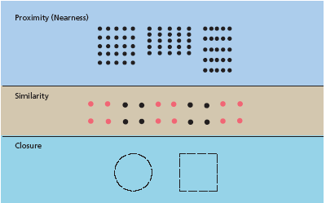
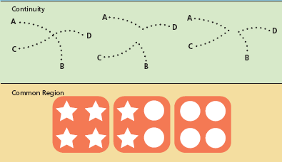
Laws of perception (Contd)

Slide 29
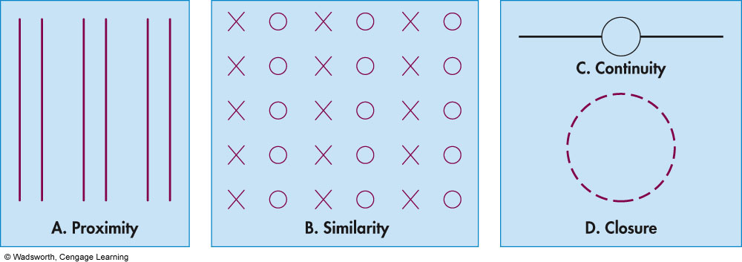
Gestalt Rules for Perceptual Organization
Notes:
Figure 4.10 Some Gestalt Laws of Perceptual Organization. These drawings illustrate the Gestalt laws of proximity, similarity, continuity, and closure.

Slide 30
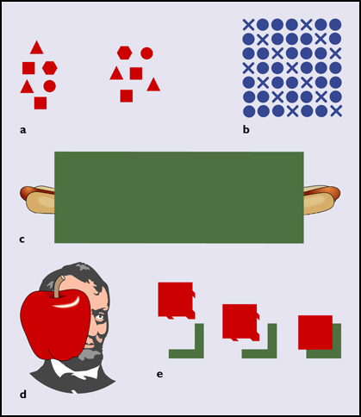
Notes:
Figure 4.51
Gestalt principles of (a) proximity, (b) similarity, (c) continuation, (d) closure, and (e) good figure.
The principle of proximity states that humans tend to perceive objects close together as belonging to a group.
The principle of similarity states that we perceive objects that resemble each other as forming a group.
We may perceive continuation, and fill in gaps in lines, or closure of familiar figures.
We tend to perceive a good figure, one that is simple and symmetrical.
Gestalt visual principles have analogs in the perception of sound

Slide 31
2.3.3. Depth perception
Our remarkable ability to judge accurately how far objects are from us or from each other is referred to as Depth or Distance Perception.
To perform this remarkable accomplishment, we rely in part on binocular cues- cues that require the use of two eyes. One is convergence, the turning of the eyes inward, which occurs when they focus on nearby object. Monocular cues- cues that require the use of one eye.

Slide 32
Depth Perception
Definition: Ability to see three-dimensional space and to accurately judge distances
Visual Cliff: Apparatus that looks like the edge of an elevated platform or cliff
Depth Cues: Features of environment, and messages, that supply information about distance and space
Our retinas are two-dimensional surfaces, but they give us very good depth perception – our ability to perceive distance
  There are several factors involved in creating our depth perception. Some are monocular cues and others are binocular cues
Monocular Depth Cue: Depth cue that can be sensed with one eye
Binocular Depth Cue: Depth cue that can be sensed with two eyes

Slide 33
Depth Perception
Monocular Cues for Depth
Monocular cues need only one eye to be perceived.
Monocular cues include perspective, clearness, overlap, shadow, and texture gradient.
The most complex monocular cue is motion parallax.
Motion parallax is the tendency of objects to seem to move forward or backward depending on how far away they are from the viewer.
Binocular Cues for Depth
Binocular cues require both eyes to be perceived.
Retinal disparity is a binocular cue for perceiving depth based on the difference between the two images of an object that the retina receives as the object moves closer.
Convergence is a binocular cue associated with feelings of tension in the eye muscles.

Slide 34
Depth Perception
Monocular cues allow a person to judge depth and distance accurately using only one eye.
  Object size can be used if we already have an idea of the approximate size of the objects.
  Linear perspective, as in the case of parallel lines that converge as they approach the horizon.
  Detail – generally objects that are closer can be seen in greater detail than those that are farther away.

Slide 35
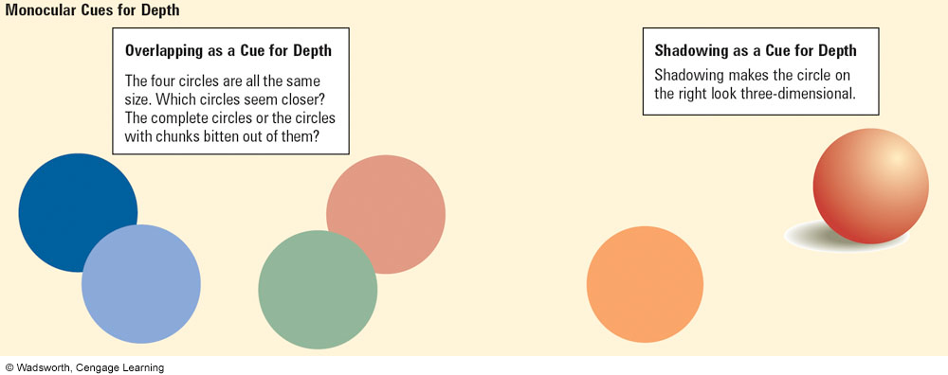
Depth Perception
Monocular Cues
  Perspective
  Clearness
  Overlapping
  Shadows
  Texture gradient
  Motion parallax
Notes:
Refer to Figure 4.11 for a demonstration of overlapping and shadowing

Slide 36
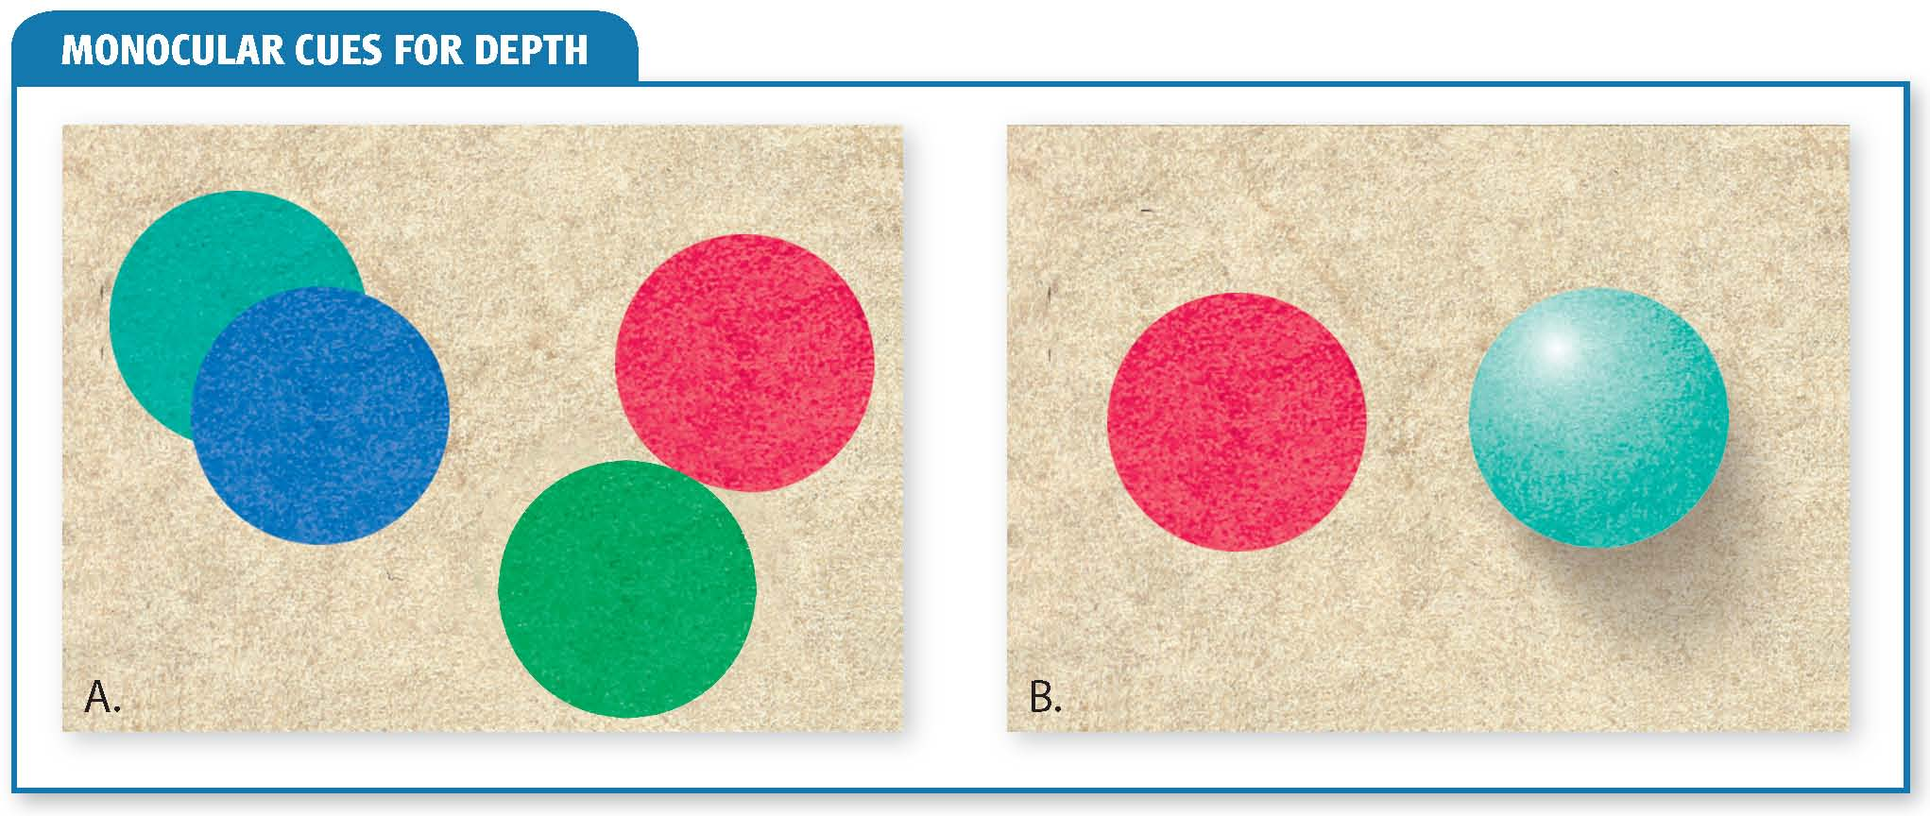
Monocular Cues

Slide 37
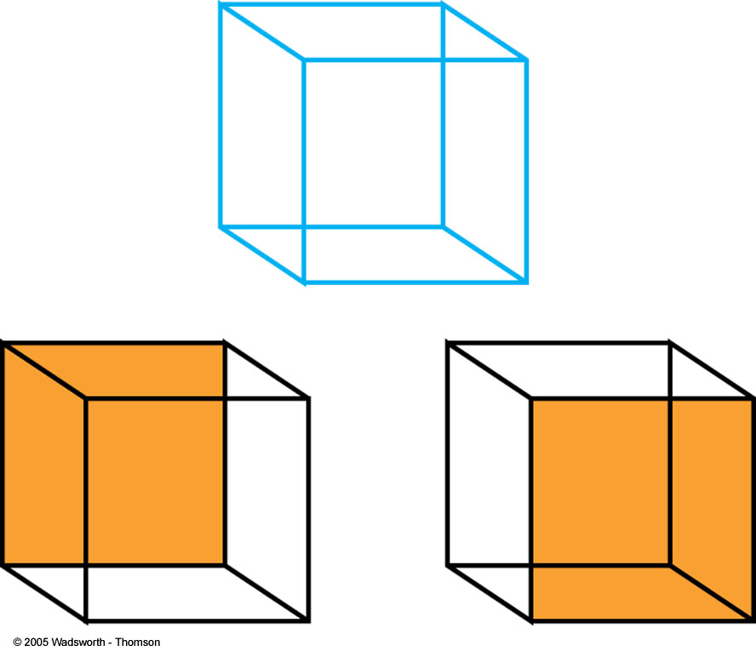
5. Depth Perception
Monocular Cues
Notes:
Refer to Figure 4.11 for a demonstration of overlapping and shadowing

Slide 38
Depth Perception
Binocular cues
  One important contributor is retinal disparity, which is the difference in apparent position of an object seen by each retina.
  This discrepancy allows us to gauge distance.
  Convergence is the degree to which our eyes must turn in to allow us to focus on a very close object.

Slide 39
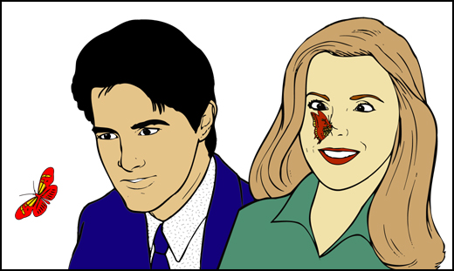
Binocular Cues
Notes:
Figure 4.56
Convergence of the eyes as a cue to distance. The more this viewer must converge her eyes toward each other in order to focus on an object, the closer the object must be.

Slide 40
2.3.4. Perceptual Constancies
Size constancy: The tendency to perceive an object as being of one size no matter how far away the object is
Shape constancy: The knowledge that an item has only one shape no matter what angle you view it from
Brightness constancy: The tendency to perceive an object as being equally bright even when the intensity of the light around it changes
Color constancy: The tendency to perceive objects as keeping their color even though different light might change the appearance of their color

Slide 41

By Kora Tushune. Network matchmaking-Brussels, January 2016

Slide 42
Perceptual Constancies
Size Constancy
The tendency to perceive an object as being of one size no matter how far away the object is.
Learned through experience
Color Constancy
The tendency to perceive objects as keeping their color even though different light might change the appearance of their color.
Learned through experience
Shape Constancy
The knowledge that an item has only one shape no matter what angle you view it from.
Learned through experience
Brightness Constancy
The tendency to perceive an object as being equally bright even when the intensity of the light around it changes.
Learned through experience

Slide 43
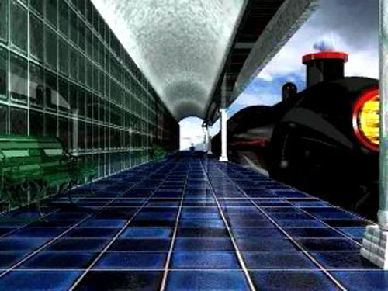
Size Constancy
Notes:
Size constancy. See a video demonstration of size constancy.

Slide 44
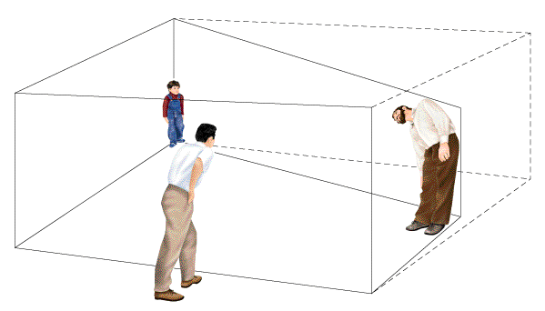
The Ames Room
A specially-built room that makes people seem to change size as they move around in it
The room is not a rectangle, as viewers assume it is
A single peephole prevents using binocular depth cues
Notes:
Sensation & Perception
©1999 Prentice Hall
Figure 3.24 from:
Kassin, S. (1998). Psychology, second edition. Upper Saddle River, NJ: Prentice Hall.

Slide 45
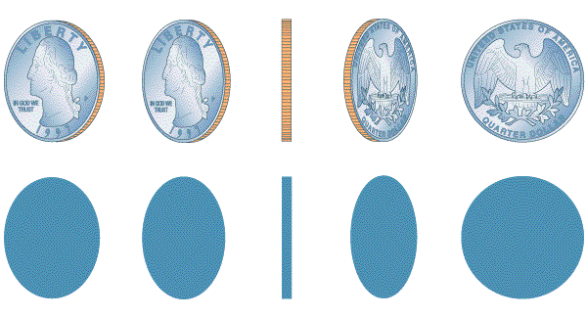
Shape Constancy
Even though these images cast shadows of different shapes, we still see the quarter as round
Notes:
Sensation & Perception
©1999 Prentice Hall
Figure 3.25 from:
Kassin, S. (1998). Psychology, second edition. Upper Saddle River, NJ: Prentice Hall.

Slide 46
2.3.5. Perceptual Illusion
Visual illusions
  A false perception of actual stimuli involving a misperception of size, shape, or the relationship of one element to another
Illusion: Misleading or distorted perceptions of stimuli that actually exist in the external world
Hallucination: When people perceive objects or events that have no external basis in reality
Muller-Lyer Illusion: Two equal-length lines topped with inward or outward pointing V’s appear to be of different length; based on experience with edges and corners

Slide 47
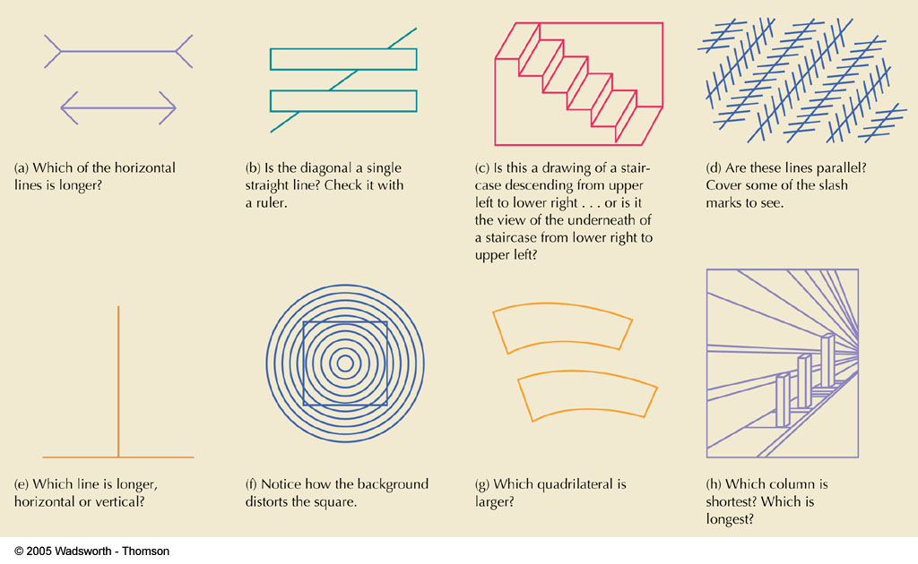
Figure 4.47
FIGURE 4.47 Some interesting perceptual illusions. Such illusions are a normal part of visual perception.

Slide 48
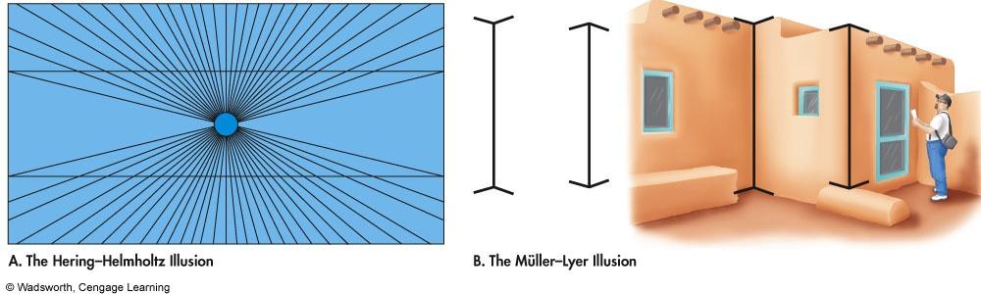
Visual Illusions
Hering-Hemlholtz Illusion
  Perceive drawing as three-dimensional
Müller-Lyer Illusion
  Interpret length of lines based on experience
Notes:
Refer to Figure 4.13 in the text for an example of both the Hering-Helmholtz and the Müller Lyer Illusion.
For some on-line examples of many of the visual phenomena, see Project Lite, an atlas of visual phenomena, created by Kenneth Brecher and Scott Gorlin and funded by an NSF Grant at http://lite.bu.edu/vision/applets/lite/lite/lite.html

Slide 49
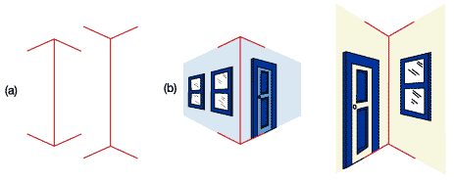
Visual
Illusions
Illusions are valuable in understanding perception because they are systematic errors.
  Illusions provide hints about perceptual strategies.
In the Muller-Lyer illusion (above) we tend to perceive the line on the right as slightly longer than the one on the left.
Notes:
Sensation & Perception
©1999 Prentice Hall
Figure 5.07 from
Wade, C., & Tavris, C. (2002). Invitation to Psychology, 2nd Ed. Upper Saddle River, NJ: Prentice Hall.

Slide 50
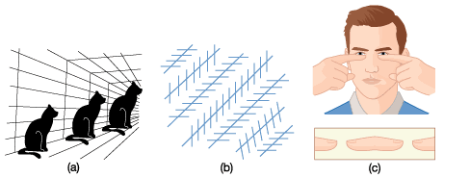
Fooling the Eye
The cats in (a) are the same size
The diagonal lines in (b) are parallel
You can create a “floating fingertip frankfurter” by holding hands as shown, 5-10” in front of face.
Notes:
Sensation & Perception
©1999 Prentice Hall

Slide 51
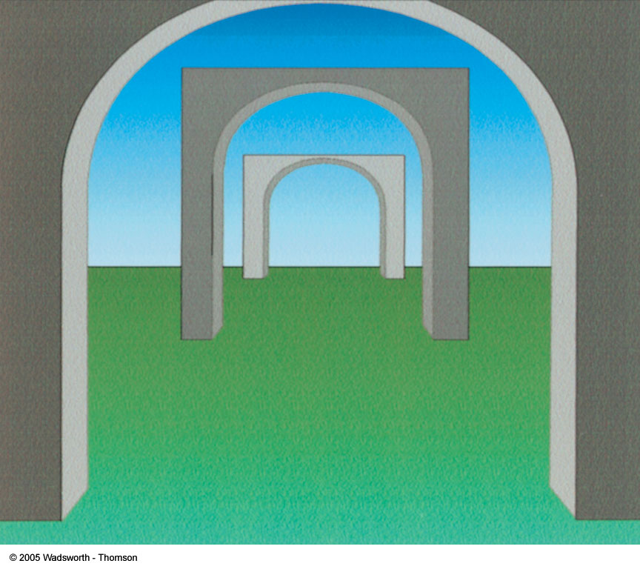
Figure 4.44
FIGURE 4.44 It is difficult to look at this simple drawing without perceiving depth. Yet, the drawing is nothing more than a collection of flat shapes. Turn this page counterclockwise 90 degrees, and you will see three C’s, one within another. When the drawing is turned sideways, it seems nearly flat. However, if you turn the page upright again, a sense of depth will reappear. Clearly, you have used your knowledge and expectations to construct an illusion of depth. The drawing itself would only be a flat design if you didn’t invest it with meaning.

Slide 52
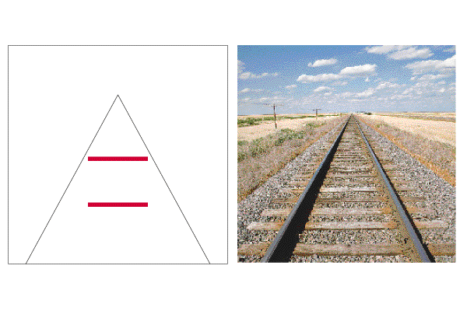
The Ponzo Illusion
Linear perspective provides context
Side lines seem to converge
Top line seems farther away
  But the retinal images of the red lines are equal!
Notes:
Sensation & Perception
©1999 Prentice Hall
Figure 3.3Davis 2 from:
Kassin, S. (1998). Psychology, second edition. Upper Saddle River, NJ: Prentice Hall.

Slide 53
Extra sensory perception (ESP)
E. W/G
    It claim that perception can occur apart from any sensory input including such paranormal phenomena astrological predictions, psychic healing, communication with the dead and out-of-body experiences
The most testable and relevant claims are
Telepathy: mind-to-mind communication without saying words
Clairvoyance: perceiving remote events without actual presence
Precognition: perceiving future events
Psychokinesis (Mind Over Matter): Purported ability to influence inanimate objects by willpower
September, 2008

Slide 54
More ESP Issues
Zener Cards: Deck of 25 cards, each having one of five symbols
Run of Luck: Statistically unusual outcome that could occur by chance alone (e.g., getting five heads in a row, two jackpots within six pulls of a slot machine)
Stage ESP: Simulation of ESP for entertainment purposes
Conclusion: Existence of ESP has NOT been scientifically demonstrated; positive results are usually inconclusive and easily criticized
  Therefore, be skeptical! If it seems too good to be true, it probably is!

Slide 55
THE END
THANK YOU VERY MUCH
E. W/G
September, 2008

